Slide 1

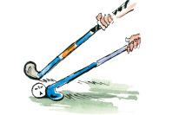



Hockey Year 5- Lesson 1
Learning Objectives:
L.O 1 –Develop pupil’s control of the hockey ball
L.O 2 – Develop pupil’s ability to dribble with stick
Challenge 1 – Pupils will be able to move and stop the ball with their stick whilst moving.
Challenge 2 – Pupils will be able to move and stop the ball whilst moving at moderate pace, changing direction and displaying a change of speed.
Challenge 3 - Can pupils uptake the role of coach? Ask pupils to detect error in pupils technique and help them to improve.
Numeracy in P.E! -
Literacy in P.E! -
Inspiration in P.E! -
SoW Milestone Focus: 4 (Display an understanding of fair play, working well with others and leading a medium sized group). 5 (Field, defend and attack tactically by anticipating the direction of play). 6 (Utilise new skills in competitive situations, as an individual or part of a team).
Field Hockey was originally known as ‘Shinty’
This was in a time when there weren’t any shinpads! Ouch!!!
1.Warm-up – Pupils start jogging around the playing area avoiding each other & listening, when the teacher calls out “French Potty!” children must freeze with their knee’s bent and their back straight! STRETCH, then repeat & move to ‘Getting familiar with the stick’ (see prev. lesson)
2. Skill intro – Dribble return: Pupils move into pairs standing one behind the other.
No.1 dribbles ball to set point, stops, turns, dribbles back and passes ball to No.2
(M/A set point further away. L/A Allowed to touch ball w/ hands.)
3. Skill progression – Cone slalom: Ask pupils to give themselves a self-evaluative score out of 5 (5 = Ryan Giggs!). If pupils score themselves 1/5 they must line up behind cone 1 and so on. Place a line of cones which pupils must attempt to navigate. Once one pupil gets half way down their slalom the next may start.
(M/A attempt to navigate the higher levels where cones are closer together., use both Open & reverse stick. L/A L1)
4. Dribbling Gates – Lay out ‘gates’ using cones around your playing area. Use 3 colours to so, Red = Large space between cones. Blue = Medium space between cones. Yellow = Small space. Let the children practice dribbling through the gates, ensuring they keep the ball close to them. PROGRESSION – Set a time limit, how many gates can you go through in 1 minute. Go! M/A can only use Yellow gates
- Time each pair and ask them to record how many shuttles they can do.

Slide 2
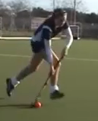
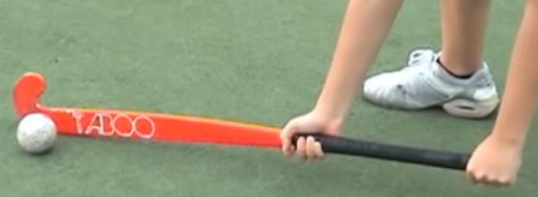
Hockey Year 5- Lesson 1
Teaching Points – Stopping the ball:
Bend knees to get close
to the floor
Place stick parallel to floor
Use largest part of the stick
Allow the ball to hit the stick, soft grip
Teaching Points – Dribbling:
Keep flat side of stick in contact
with the ball
Keep the ball close
Glance at ball and where
you are travelling
Skill intro – ‘Getting familiar with the stick’
Pupils spread out evenly
Mark out a large grid using cones
all pupils find a space within grid.
M/A – Flat side throughout, L/A – Can use hands
Dribble Return
Cone slalom
Dribbling Gates
Red = Large space between cones. Blue = Medium space between cones.
Yellow = Small space. Let the children practice dribbling through the gates,
ensuring they keep the ball close to them. PROGRESSION – Set a time limit,
how many gates can you go through in 1 minute. Go!
M/A can only use Yellow gates

Slide 3
Hockey Year 5- Lesson 2
Learning Objectives:
L.O 1 – Develop pupil’s ability to pass the Hockey ball to teammates
L.O 2 – Develop pupil’s ability to apply skill in a competitive environment
Challenge 1 – Pupils can stop and pass the ball in isolation with consistency (4/5 times out of 5 at 5m distance – Tennis/Hockey ball)
Challenge 2 – Pupils can stop and pass the ball in a conditioned game scenario with moderate consistency (2/3 times out of 5 – Tennis/Hockey ball)
Challenge 3 – Can pupils use teaching points to help others improve their technique?
Numeracy in P.E! -
Literacy in P.E! -
Inspiration in P.E! -
SoW Milestone Focus: 4 (Display an understanding of fair play, working well with others and leading a medium sized group). 5 (Field, defend and attack tactically by anticipating the direction of play). 6 (Utilise new skills in competitive situations, as an individual or part of a team).
1.Warm-up – Pupils start jogging around the playing area avoiding each other & listening, when the teacher calls out “French Potty!” children must freeze with their knee’s bent and their back straight! STRETCH, then repeat & move to ‘Getting familiar with the stick’ (see prev. lesson)
2. Dribbling Gates – Lay out ‘gates’ using cones around your playing area. Use 3 colours to so, Red = Large space between cones. Blue = Medium space between cones. Yellow = Small space. Let the children practice dribbling through the gates, ensuring they keep the ball close to them. PROGRESSION – Set a time limit, how many gates can you go through in 1 minute. Go! M/A can only use Yellow gates
3. Passing in pairs: Pupils organised into pairs of similar ability (use Coloured bibs to make this easier, Blue must partner up with a blue etc). Pupils practice skill in isolation, opposite partner. Control, pass, control, pass. M/A pupils should practice the skill over a greater distance, w/ both feet. L/A Close together.
3. Passing gates (In pairs): Spread pairs out around space. Pupils must try to pass the ball to their partner through a gate. Set a time limit and see how many gates they can complete. Each gate equals a point. M/A Use smaller gates. L/A Use larger gates
Red = Large space between cones. Blue = Medium space between cones. Yellow = Small space.

Slide 4
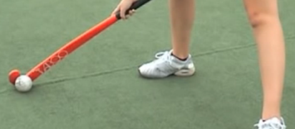
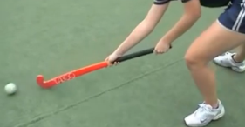
Hockey Year 5- Lesson 2
Teaching Points – Stopping the ball:
Bend knees to get close
to the floor
Place stick parallel to floor
Use largest part of the stick
Allow the ball to hit the stick, soft grip
Teaching Points – Push Passing:
Keep flat side of stick in contact
with the ball
Drag ball from outside of right
foot until level with left foot
Push ball softly to target
‘Getting familiar with the stick’
Dribbling Gates
Passing in pairs
Pupils practice skill in isolation, opposite partner.
Control, pass, control, pass.
M/A pupils should practice the skill over a greater distance,
L/A Close together.
Passing Gates
Red = Large space between cones. Blue = Medium space between cones.
Yellow = Small space. Let the children practice passing through the gates,
ensuring they keep the ball close to them. PROGRESSION – Set a time limit,
how many gates can you pass through in 1 minute. Go!
M/A can only use Yellow gates

Slide 5
Hockey Year 5- Lesson 3
Learning Objectives:
L.O 1 – Develop pupil’s ability to pass the Hockey ball to teammates
L.O 2 – Develop pupil’s ability to apply skill in a competitive environment
Challenge 1 – Pupils can stop and pass the ball in isolation with consistency (4/5 times out of 5 at 5m distance – Tennis/Hockey ball)
Challenge 2 – Pupils can stop and pass the ball in a conditioned game scenario with moderate consistency (2/3 times out of 5 – Tennis/Hockey ball)
Challenge 3 – Can pupils use teaching points to help others improve their technique?
Numeracy in P.E! -
Literacy in P.E! -
Inspiration in P.E! -
SoW Milestone Focus: 4 (Display an understanding of fair play, working well with others and leading a medium sized group). 5 (Field, defend and attack tactically by anticipating the direction of play). 6 (Utilise new skills in competitive situations, as an individual or part of a team).
1.Warm-up – Pupils start jogging around the playing area avoiding each other & listening, when the teacher calls out “French Potty!” children must freeze with their knee’s bent and their back straight! STRETCH, then repeat & move to ‘Getting familiar with the stick’ (see prev. lesson)
2. Passing in pairs: Pupils organised into pairs of similar ability (use Coloured bibs to make this easier, Blue must partner up with a blue etc). Pupils practice skill in isolation, opposite partner. Control, pass, control, pass. M/A pupils should practice the skill over a greater distance, w/ both feet. L/A Close together.
3. Passing gates (In pairs): Spread pairs out around space. Pupils must try to pass the ball to their partner through a gate. Set a time limit and see how many gates they can complete. Each gate equals a point. M/A Use smaller gates. L/A Use larger gates
Red = Large space between cones. Blue = Medium space between cones. Yellow = Small space.
4. Keepball – Our children are now ready to execute their push pass against opposition. The way that we start to introduce them to this skill is through ‘Keepball’. Mark out some large grids (we want to set up these exercises to favour the ‘passers’ not the ‘defender’), within which we want a team of 5 or 6 to keep the ball away from the defender who tries to intercept it!. PROGRESSION – Set an amount of passes as a target, if the ‘passers’ meet this – they get a goal! Ensure that M/A play with children of a similar ability, likewise for L/A.

Slide 6
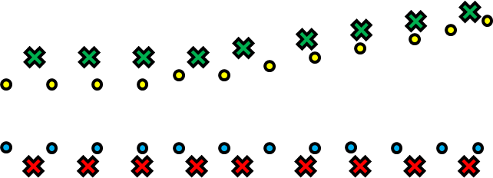
Hockey Year 5- Lesson 3
Teaching Points – Stopping the ball:
Bend knees to get close
to the floor
Place stick parallel to floor
Use largest part of the stick
Allow the ball to hit the stick, soft grip
Teaching Points – Push Passing:
Keep flat side of stick in contact
with the ball
Drag ball from outside of right
foot until level with left foot
Push ball softly to target
‘Getting familiar with the stick’
Passing in Pairs
Passing Gates
Red = Large space between cones. Blue = Medium space between cones.
Yellow = Small space. Let the children practice passing through the gates,
ensuring they keep the ball close to them. PROGRESSION – Set a time limit,
how many gates can you pass through in 1 minute. Go!
M/A can only use Yellow gates
‘Keepball’
Mark out some large grids (we want to set up these exercises to favour the ‘passers’
not the ‘defender’), within which we want a team of 5 or 6 to keep the ball away from
the defender who tries to intercept it!. PROGRESSION – Set an amount of passes as a
target, if the ‘passers’ meet this – they get a goal! Ensure that M/A play with
children of a similar ability, likewise for L/A.

Slide 7
Hockey Year 5- Lesson 4
Learning Objectives:
L.O 1 – Develop pupil’s ability to pass the Hockey ball to teammates
L.O 2 – Develop pupil’s ability to apply skill in a competitive environment
Challenge 1 – Pupils can stop and pass the ball in isolation with consistency (4/5 times out of 5 at 5m distance – Tennis/Hockey ball)
Challenge 2 – Pupils can stop and pass the ball in a conditioned game scenario with moderate consistency (2/3 times out of 5 – Tennis/Hockey ball)
Challenge 3 – Can pupils use teaching points to help others improve their technique?
Numeracy in P.E! -
Literacy in P.E! -
Inspiration in P.E! -
SoW Milestone Focus: 4 (Display an understanding of fair play, working well with others and leading a medium sized group). 5 (Field, defend and attack tactically by anticipating the direction of play). 6 (Utilise new skills in competitive situations, as an individual or part of a team).
1.Warm-up – Pupils start jogging around the playing area avoiding each other & listening, when the teacher calls out “French Potty!” children must freeze with their knee’s bent and their back straight! STRETCH, then repeat & move to ‘Getting familiar with the stick’ (see prev. lesson)
2. Passing gates (In pairs): Spread pairs out around space. Pupils must try to pass the ball to their partner through a gate. Set a time limit and see how many gates they can complete. Each gate equals a point. M/A Use smaller gates. L/A Use larger gates
Red = Large space between cones. Blue = Medium space between cones. Yellow = Small space.
3. Keepball – Our children are now ready to execute their push pass against opposition. The way that we start to introduce them to this skill is through ‘Keepball’. Mark out some large grids (we want to set up these exercises to favour the ‘passers’ not the ‘defender’), within which we want a team of 5 or 6 to keep the ball away from the defender who tries to intercept it!. PROGRESSION – Set an amount of passes as a target, if the ‘passers’ meet this – they get a goal! Ensure that M/A play with children of a similar ability, likewise for L/A.
4. ‘4 Square’ – In the game of ‘4 square’ a pitch is made up of quarters. Each team consists of 4 players (one in each quarter). The team with the ball has to attempt to pass the ball into every quarter in order they wish. When one player receives a pass, the opposition player in that quarter must step out to allow them to attempt to make a pass to a team mate. The opposition stay in the remaining quarters and attempt to intercept the pass. L/A players will play in bigger area’s, M/A players play the game in smaller areas

Slide 8
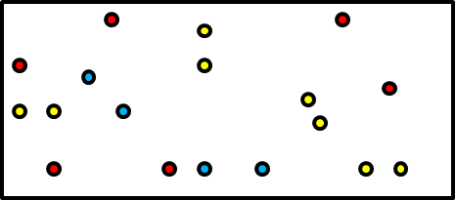
Hockey Year 5- Lesson 4
Teaching Points – Stopping the ball:
Bend knees to get close
to the floor
Place stick parallel to floor
Use largest part of the stick
Allow the ball to hit the stick, soft grip
Teaching Points – Push Passing:
Keep flat side of stick in contact
with the ball
Drag ball from outside of right
foot until level with left foot
Push ball softly to target
‘Getting familiar with the stick’
Passing Gates
‘Keepball’
Mark out some large grids (we want to set up these exercises to favour the ‘passers’
not the ‘defender’), within which we want a team of 5 or 6 to keep the ball away from
the defender who tries to intercept it!. PROGRESSION – Set an amount of passes as a
target, if the ‘passers’ meet this – they get a goal! Ensure that M/A play with
children of a similar ability, likewise for L/A.
‘4 Square’
The team with the ball has to attempt to pass the ball into every quarter in order they
wish. When one player receives a pass, the opposition player in that quarter must step
out to allow him to attempt to make a pass to a team mate. The opposition stay in the
remaining quarters and attempt to intercept the pass. L/A players will play in bigger
area’s, M/A players play the game in smaller areas
Stepped out to allow player to attempt pass
Player with the ball

Slide 9
Hockey Year 5- Lesson 5
Learning Objectives:
L.O 1 – Develop pupil’s ability to pass the Hockey ball to teammates
L.O 2 – Develop pupil’s ability to apply skill in a competitive environment
Challenge 1 – Pupils can stop and pass the ball in isolation with consistency (4/5 times out of 5 at 5m distance – Tennis/Hockey ball)
Challenge 2 – Pupils can stop and pass the ball in a conditioned game scenario with moderate consistency (2/3 times out of 5 – Tennis/Hockey ball)
Challenge 3 – Can pupils use teaching points to help others improve their technique?
Numeracy in P.E! -
Literacy in P.E! -
Inspiration in P.E! -
SoW Milestone Focus: 4 (Display an understanding of fair play, working well with others and leading a medium sized group). 5 (Field, defend and attack tactically by anticipating the direction of play). 6 (Utilise new skills in competitive situations, as an individual or part of a team).
1.Warm-up – Pupils start jogging around the playing area avoiding each other & listening, when the teacher calls out “French Potty!” children must freeze with their knee’s bent and their back straight! STRETCH, then repeat & move to ‘Getting familiar with the stick’ (see prev. lesson)
2. Keepball – Our children are now ready to execute their push pass against opposition. The way that we start to introduce them to this skill is through ‘Keepball’. Mark out some large grids (we want to set up these exercises to favour the ‘passers’ not the ‘defender’), within which we want a team of 5 or 6 to keep the ball away from the defender who tries to intercept it!. PROGRESSION – Set an amount of passes as a target, if the ‘passers’ meet this – they get a goal! Ensure that M/A play with children of a similar ability, likewise for L/A.
3. ‘4 Square’ – In the game of ‘4 square’ a pitch is made up of quarters. Each team consists of 4 players (one in each quarter). The team with the ball has to attempt to pass the ball into every quarter in order they wish. When one player receives a pass, the opposition player in that quarter must step out to allow him to attempt to make a pass to a team mate. The opposition stay in the remaining quarters and attempt to intercept the pass. L/A players will play in bigger area’s, M/A players play the game in smaller areas
4. Battleships (Passing Accuracy) - 4. Battleships! – For battleships the children will work in pairs. They will need 5 cones for each working group, one to mark out the passing mark, this the where the ball must be placed. The other 4 create targets (or ‘ships’). Each child has 4 lives, ‘child number 1’ must announce which colour they are aiming at. If they hit that colour with their pass, they sink the ship! It is then ‘child number 2’s’ turn to try and sink a ship. The child that sinks all 4 ships first wins! L/A take aim from closer together, replace cones with larger targets if you need to. M/A take aim from further away!

Slide 10
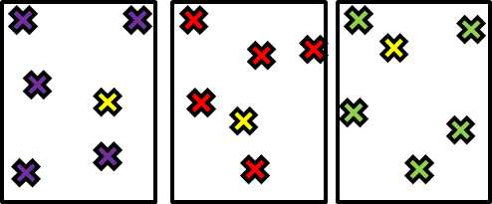

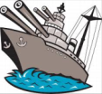
Hockey Year 5- Lesson 5
Teaching Points – Stopping the ball:
Bend knees to get close
to the floor
Place stick parallel to floor
Use largest part of the stick
Allow the ball to hit the stick, soft grip
Teaching Points – Push Passing:
Keep flat side of stick in contact
with the ball
Drag ball from outside of right
foot until level with left foot
Push ball softly to target
‘Getting familiar with the stick’
Keepball
‘4 Square’
The team with the ball has to attempt to pass the ball into every quarter in order they
wish. When one player receives a pass, the opposition player in that quarter must step
out to allow him to attempt to make a pass to a team mate. The opposition stay in the
remaining quarters and attempt to intercept the pass. L/A players will play in bigger
area’s, M/A players play the game in smaller areas
Stepped out to allow player to attempt pass
Player with the ball
4. Battleships!
The first child to sink all
4 ships wins!
To sink a ship a child needs to pass a ball at a cone successfully.
M/A to take aim from further away, L/A to move closer

Slide 11
Hockey Year 5- Lesson 6
Learning Objectives:
L.O 1 – Develop pupil’s ability to pass the Hockey ball to teammates
L.O 2 – Develop pupil’s ability to apply skill in a competitive environment
Challenge 1 – Pupils can stop and pass the ball in isolation with consistency (4/5 times out of 5 at 5m distance – Tennis/Hockey ball)
Challenge 2 – Pupils can stop and pass the ball in a conditioned game scenario with moderate consistency (2/3 times out of 5 – Tennis/Hockey ball)
Challenge 3 – Can pupils use teaching points to help others improve their technique?
Numeracy in P.E! -
Literacy in P.E! -
Inspiration in P.E! -
SoW Milestone Focus: 4 (Display an understanding of fair play, working well with others and leading a medium sized group). 5 (Field, defend and attack tactically by anticipating the direction of play). 6 (Utilise new skills in competitive situations, as an individual or part of a team).
1.Warm-up – Pupils start jogging around the playing area avoiding each other & listening, when the teacher calls out “French Potty!” children must freeze with their knee’s bent and their back straight! STRETCH, then repeat & move to ‘Getting familiar with the stick’ (see prev. lesson)
2. ‘4 Square’ – In the game of ‘4 square’ a pitch is made up of quarters. Each team consists of 4 players (one in each quarter). The team with the ball has to attempt to pass the ball into every quarter in order they wish. When one player receives a pass, the opposition player in that quarter must step out to allow him to attempt to make a pass to a team mate. The opposition stay in the remaining quarters and attempt to intercept the pass. L/A players will play in bigger area’s, M/A players play the game in smaller areas
3. Battleships (Passing Accuracy) - 4. Battleships! – For battleships the children will work in pairs. They will need 5 cones for each working group, one to mark out the passing mark, this the where the ball must be placed. The other 4 create targets (or ‘ships’). Each child has 4 lives, ‘child number 1’ must announce which colour they are aiming at. If they hit that colour with their pass, they sink the ship! It is then ‘child number 2’s’ turn to try and sink a ship. The child that sinks all 4 ships first wins! L/A take aim from closer together, replace cones with larger targets if you need to. M/A take aim from further away!
4. Open & Fire! – Using the same equipment and organisation as battleships, modify the activity so it becomes ‘Open & Fire’!
This time one player takes the role of the feeder, they pass the ball to the other player who controls the ball, dribbles around the cones and then shoots at the targets! Let the shooters have ¾ shots before asking them to swap roles. Ask your M/A to shoot from further away!

Slide 12
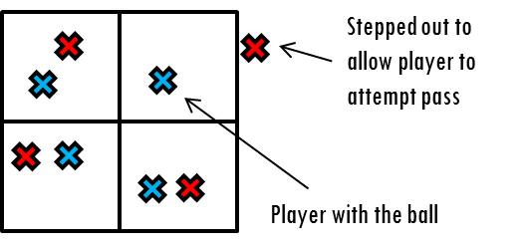

Hockey Year 5- Lesson 6
Teaching Points – Stopping the ball:
Bend knees to get close
to the floor
Place stick parallel to floor
Use largest part of the stick
Allow the ball to hit the stick, soft grip
Teaching Points – Push Passing:
Keep flat side of stick in contact
with the ball
Drag ball from outside of right
foot until level with left foot
Push ball softly to target
‘Getting familiar with the stick’
‘4 Square’
Battleships!
The first child to sink all
4 ships wins!
To sink a ship a child needs to pass a ball at a cone successfully.
M/A to take aim from further away, L/A to move closer
Open & Fire!
One player takes the role of the feeder, they pass the ball to
the other player who controls the ball, dribbles around the cones
and then shoots at the targets! Let the shooters have ¾ shots
before asking them to swap roles.
Ask your M/A to shoot from further away!
Shoot before here
Obstacle cones

